Slide 1
Strathmore University
Data Science Introduction
Information Systems & Data Science
By
Christopher Njunge, PhD

Slide 2
Outline
Information Systems (IS) Themes
Information Systems
Information Technology
Organization
People
Business Context
Data (A lot)
Data Science
Business Understanding
Data Understanding and Preparation
Modeling and Evaluation
Deployment
Discussion

Slide 3

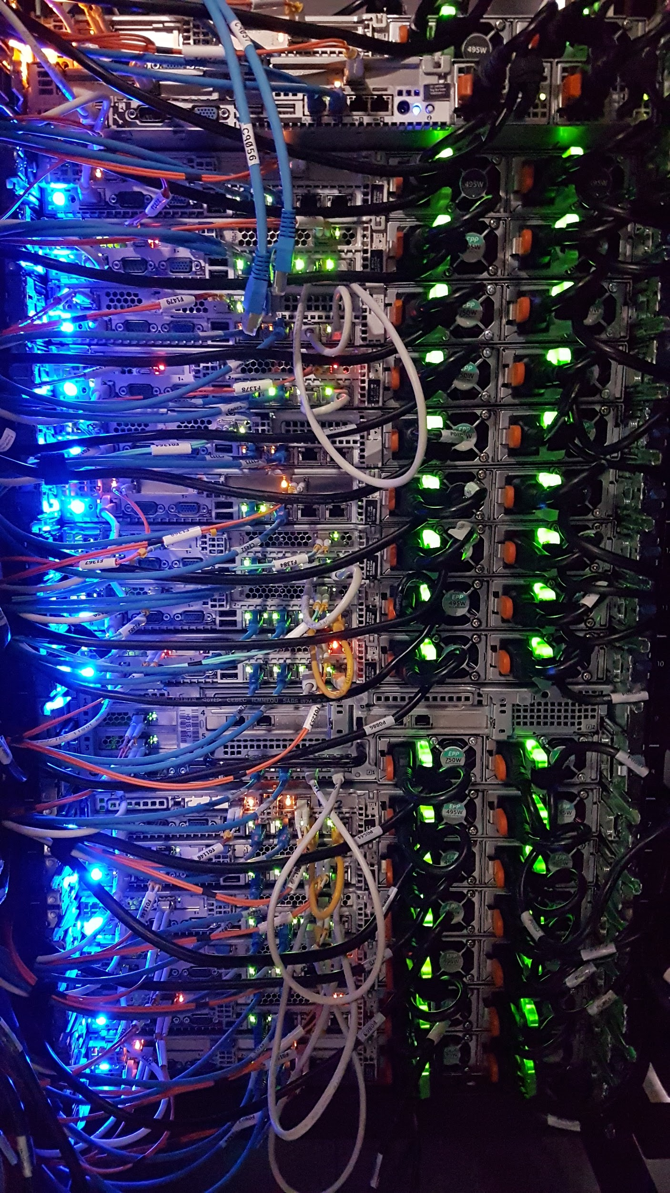

1, a, i) IS - Information Technology
https://cybermap.kaspersky.com/

Slide 4




1, a, ii) IS - Organization

Slide 5




1, a, iii) IS - People

Slide 6
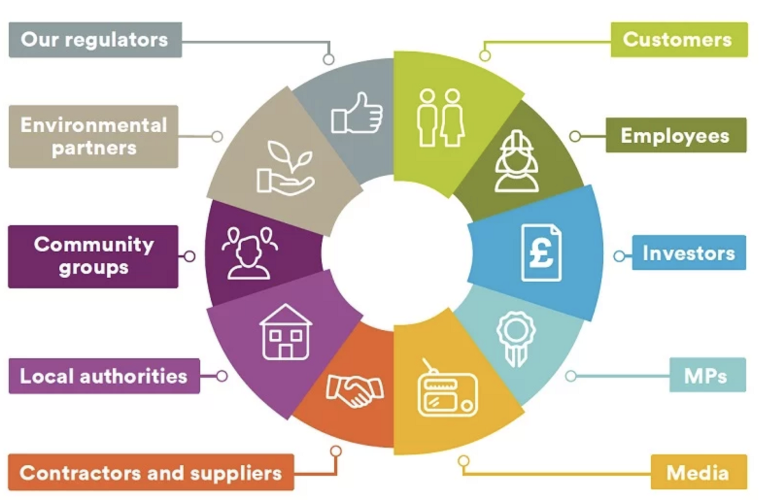
1, b) Business Context

Slide 7


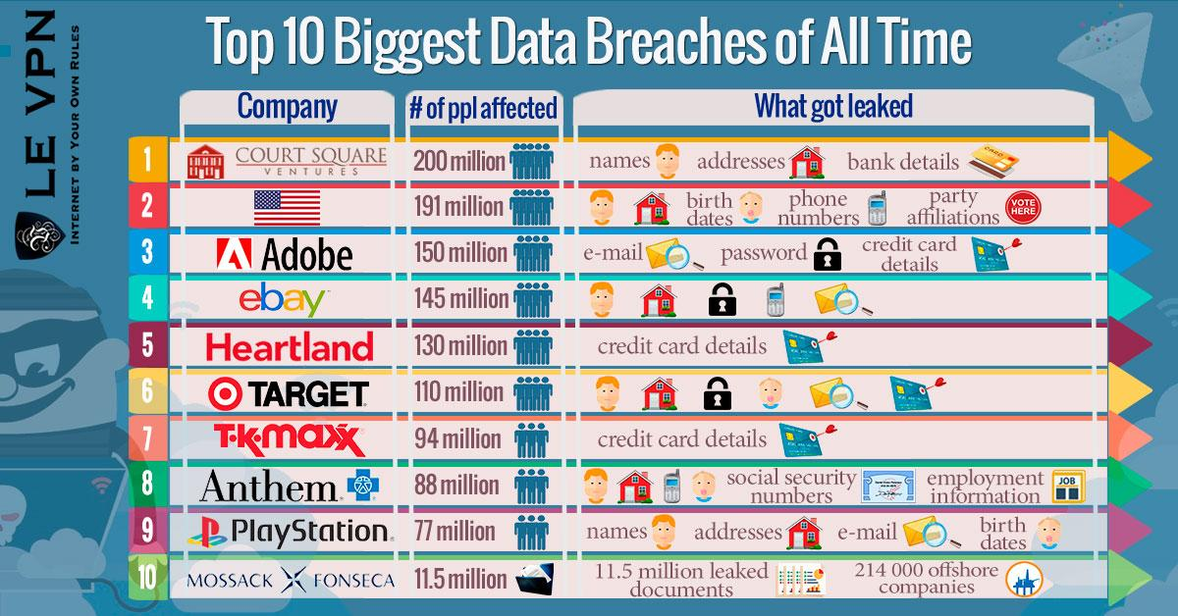
1, c) Data (A lot)
https://informationisbeautiful.net/visualizations/who-old-are-you/
https://informationisbeautiful.net/visualizations/top-500-passwords-visualized/

Slide 8

2) Data Science Theory: CRISP-DM

Slide 9
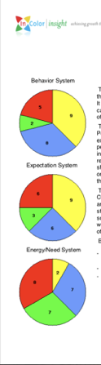
2, a) Business Understanding (Empathy)
Individuals
Personality and Values
Decision Making
Motivation
Groups
Teams
Communication
Leadership
Organization
Structure, Power and Politics
Conflict and Negotiation
Change and Stress

Slide 10
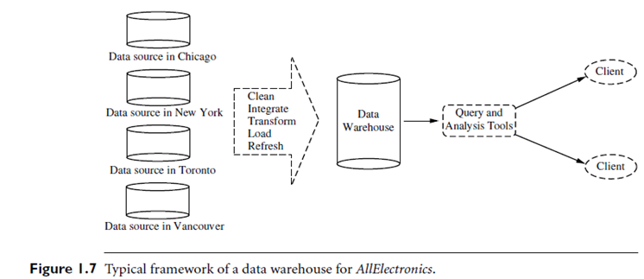
2, b) Data Understanding
Data Sources
Data Owners (SMEs)
Update Frequency
Data Objects and Attribute Types (Nominal, Binary, Ordinal, Numeric)

Slide 11
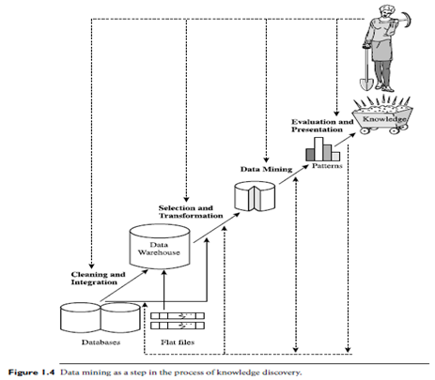
2, b) Data Preparation
Data Cleaning (to remove noise and inconsistent data)
Data Integration (where multiple data sources may be combined)
Data Selection (where data relevant to the analysis task are retrieved from the database or other data source
Data Transformation (where data are transformed and consolidated by performing summary or aggregation operations)

Slide 12
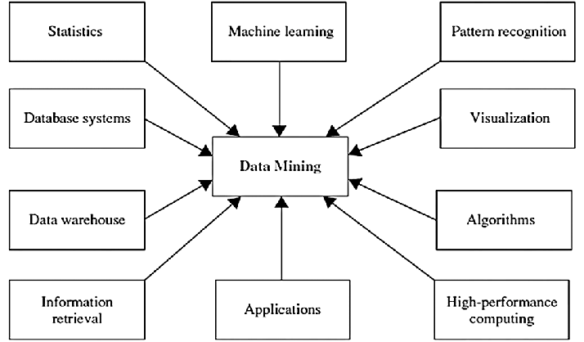
2, c) Modeling and Evaluation

Slide 13
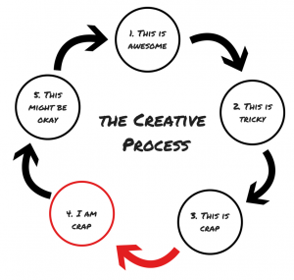
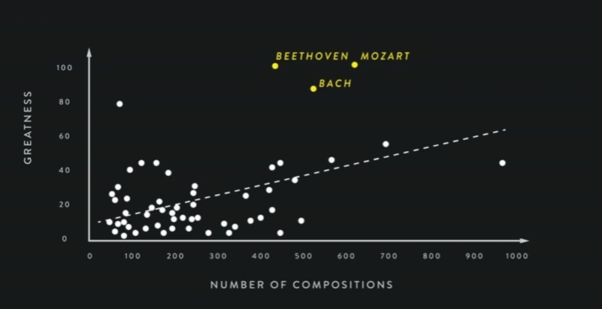
2, d) Deployment

Slide 14
Discussion

